Slide 1
Linked list
consists of group of nodes in a sequence.
Each node holds its own data and the address of the next node hence forming a chain like structure.
Advantages of Linked Lists
They are a dynamic in nature which allocates the memory when required.
Insertion and deletion operations can be easily implemented.
Stacks and queues can be easily executed.
Linked List reduces the access time.

Slide 2
Linked list
Disadvantages of Linked Lists
The memory is wasted as pointers require extra memory for storage.
No element can be accessed randomly; it has to access each node sequentially.
Reverse Traversing is difficult in linked list.
Applications of Linked Lists
Linked lists are used to implement stacks, queues, graphs, etc.
Linked lists let you insert elements at the beginning and end of the list.
In Linked Lists we don't need to know the size in advance.

Slide 3
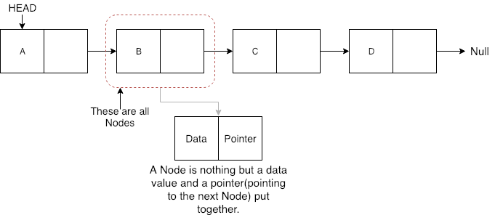
What is a Node?
A Node in a linked list holds the data value and the pointer which points to the location of the next node in the linked list.

Slide 4
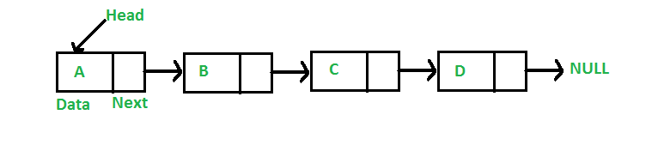
Singly Linked List
class Node
{
public int data;
public Node *next;
};
Node
Each element in the List
consists of at least two parts:
Data
Pointer (Or Reference) to the next node
Tracking Element : Head/First
Linked List

Slide 5
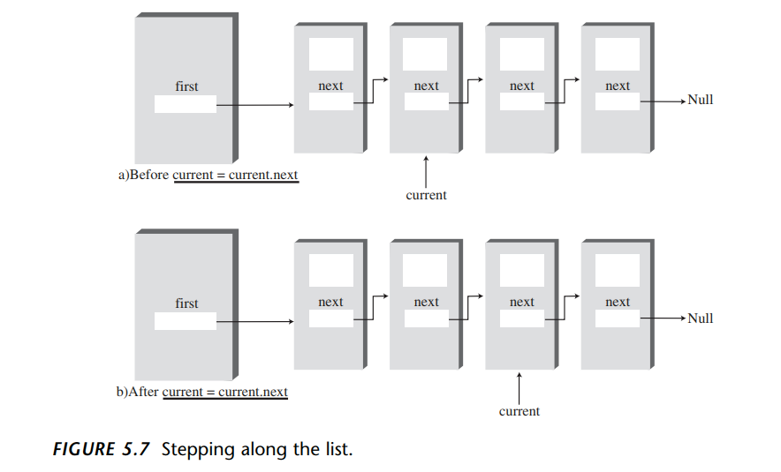
Linked List: Accessing Element

Slide 6
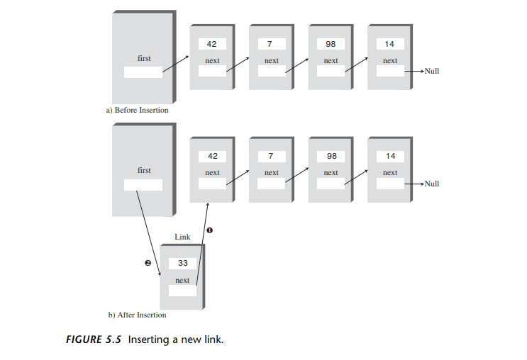
Linked List:Insertion of Element

Slide 7
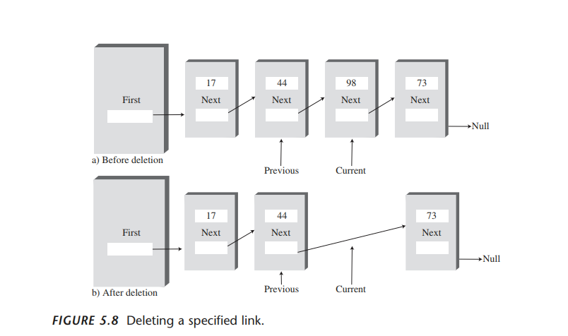
Linked List:Deletion of Element

Slide 8
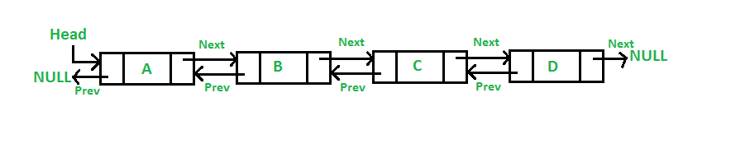
Doubly Linked List
class Node
{
public int data;
public Node *next;
public Node *prev;
};
Node
Each element in the List
consists of at least three parts:
Data
Pointer (Or Reference) to the next node
Pointer Or Reference) to the previous node
Tracking Element : Head/First and Last/Tail
Linked List

Slide 9
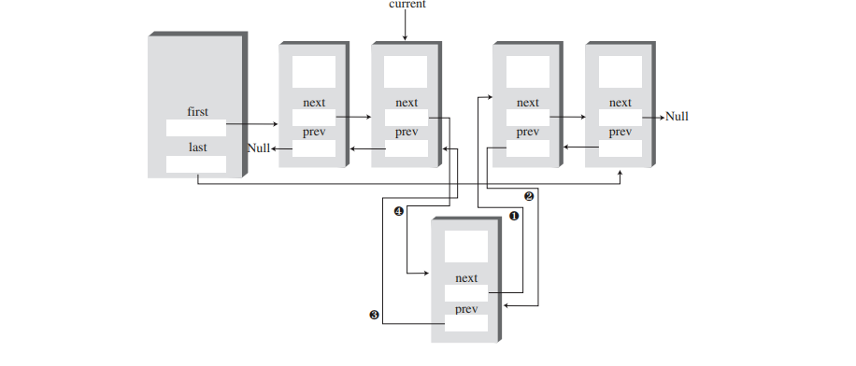
Doubly Linked List:Insertion of Element

Slide 10
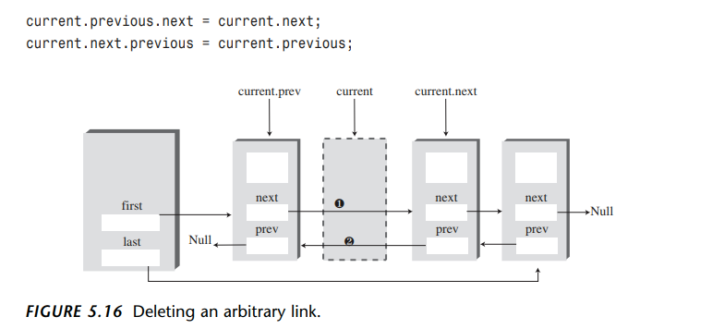
Doubly Linked List:Deletion of Element

Slide 11
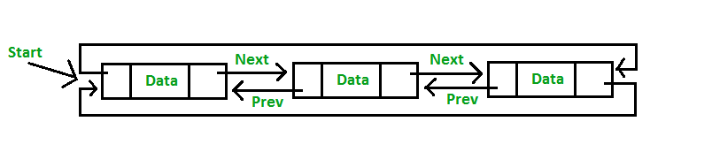
Circular Linked List
class Node
{
public int data;
public Node *next;
public Node *prev;
};
Node
consists of at least three parts:
Data
Pointer (Or Reference) to the next node
Pointer Or Reference) to the previous node
Two consecutive elements are linked or connected by previous and next pointer
Last node points to first node by next pointer
First node points to last node by previous pointer
Linked List

